Slide 1



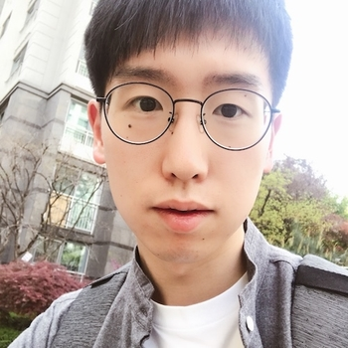
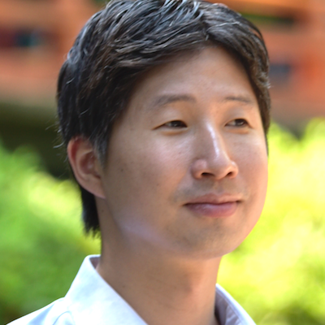

Abstractive Summarization of Posts with Multi-level Memory Networks
NAACL-HLT 2019
(Selected for oral presentation)
Byeongchang
Kim
Hyunwoo
Kim
Gunhee
Kim
Notes:
Hello, My name is Byeongchang and I will present our work on reddit posts summarization.
This is joint work with my colleague Hyunwoo and my advisor Gunhee.

Slide 2

Summarization?
Morehouse College seniors got a surprise Sunday when billionaire Robert F. Smith announced that he would pay off the student loan debt. "On behalf of the eight generations of my family who have been in this country, we're going to put a little fuel in your bus," he told the newly minted graduates in Atlanta before saying his family was creating a grant to eliminate their student loans. The announcement was met with a standing ovation and chants of "MVP!” "Now, I know my class will make sure they pay this forward," he continued. "I want my class to look at these (alumni) -- these beautiful Morehouse brothers -- and let's make sure every class has the same opportunity going forward because we are enough to take care of our own community. We are enough to ensure we have all the opportunities of the American dream.” The total amount covered for the 396 students is up to
Gold Summary (answer):
Morehouse College grads are surprised by a billionaire's promise to pay off their student loans.
Notes:
The task of summarization is given an article, we have to produce an short version of a text. Of course it has to contain key information.

Slide 3


Two approaches for summarization
Extractive
Abstractive
Pick out the most suitable sentence
Generate a new sentence
Notes:
And in the summarization domain, there are two approaches. Extractive and Abstractive.
As you can see extractive methods select a sentence in the source text. (Like highlighting a sentence)
Whereas abstractive methods newly generate a summary sentence by its own.

Slide 4







Existing summarization datasets
News Agencies
= Formal documents
Notes:
However, the existing datasets are all basically formal documents. News articles are the most dominant dataset,
And actually, almost every dataset are news articles. Like Newyork Times and CNN Daily Mail

Slide 5
Problems with existing datasets
Gold Summary (answer):
Morehouse College seniors got a surprise Sunday when billionaire Robert F. Smith announced that he would pay off the student loan debt. "On behalf of the eight generations of my family who have been in this country, we're going to put a little fuel in your bus," he told the newly minted graduates in Atlanta before saying his family was creating a grant to eliminate their student loans. The announcement was met with a standing ovation and chants of "MVP!” "Now, I know my class will make sure they pay this forward," he continued. "I want my class to look at these (alumni) -- these beautiful Morehouse brothers -- and let's make sure every class has the same opportunity going forward because we are enough to take care of our own community. We are enough to ensure we have all the opportunities of the American dream.” The total amount covered for the 396 students is up to
Morehouse College grads are surprised by a billionaire's promise to pay off their student loans.
Notes:
We happen to DISCOVER that there are some problems with these existing datasets. Or to be more precise, formal documents have some bias in them.
Recall the previous slide, the gold was this. However this was actually very similar to the “First” sentence or the “Leading” sentence.

Slide 6
Problems with existing datasets 1: Lead bias
Relative locations of bigrams of reference summary in source text
Newsroom
[Grusky et al. 2018]
CNN/DailyMail
[Nallapati et al. 2016]
Notes:
To show it analytically, we computed relative location of the the gold summary’s bigrams inside the text.
As a result, we verified that most of the words in the answer summary were concentrated in the beginning of the text and we call it lead bias.

Slide 7
Problems with existing datasets
Gold Summary (answer):
Morehouse College seniors got a surprise Sunday when billionaire Robert F. Smith announced that he would pay off the student loan debt. "On behalf of the eight generations of my family who have been in this country, we're going to put a little fuel in your bus," he told the newly minted graduates in Atlanta before saying his family was creating a grant to eliminate their student loans. The announcement was met with a standing ovation and chants of "MVP!” "Now, I know my class will make sure they pay this forward," he continued. "I want my class to look at these (alumni) -- these beautiful Morehouse brothers -- and let's make sure every class has the same opportunity going forward because we are enough to take care of our own community. We are enough to ensure we have all the opportunities of the American dream.” The total amount covered for the 396 students is up to
Morehouse College grads are surprised by a billionaire's promise to pay off their student loans.
The biases of
Formal documents
The leading sentence of a text
Almost identical sentence already inside the text
=Extractive-friendly!
Notes:
This is not a coincidence. Formal documents have tendencies that key information is concentrated on the Leading sentence.
And sentences that are almost identical to the gold summary already exists inside the text.
These biases mean that you can just highlight off the sentence in the text not even knowing what the document is about and get a great score for summarization.
This means datasets are more friendly to extractive methods.

Slide 8

Previous Solutions
The meat-less burger trend is growing fast than most people expected.
Collecting articles from
diverse news agencies
[Grusky et al. 2018]
Use lead sentence as
a reference summary
[Narayan et al. 2018]
Notes:
There are previous works on dealing with these issues.
Grusky et al from Cornell university solve this issue by collecting articles from diverse news publications and released dataset named Newsroom.
And Narayan et al. from Edinburgh university resolve this issue by regarding intro sentences as a gold summary and released XSum dataset.

Slide 9
Online discussion forum
TIFU
Today, I F****ed Up
Notes:
But our solution is to build a new dataset from a completely different domain.
So, we made a new dataset based on online discussion forum reddit, and especially subreddit tifu, which refers to today I messed up.
This is a subreddit where people share experiences about how they got in trouble.
It also has great features that are excellent for summarization.
여기서 today, I fucked up을 굳이 넣을 필요가 없을것같다. TIFU가 뭔지 설명하는 짧은 글을 넣는것도 괜찮을듯

Slide 10
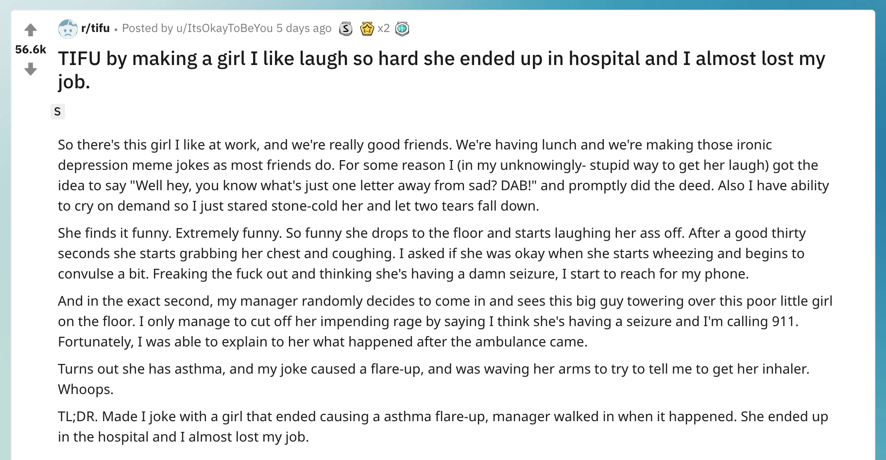
TIFU
Short
Summary
Source
Text
Long
Summary
Notes:
Let’s see the example post.
The title is a short summary of the text. And below with the tldr mark, there is a longer summary of the text.
And use main text as source text.

Slide 11
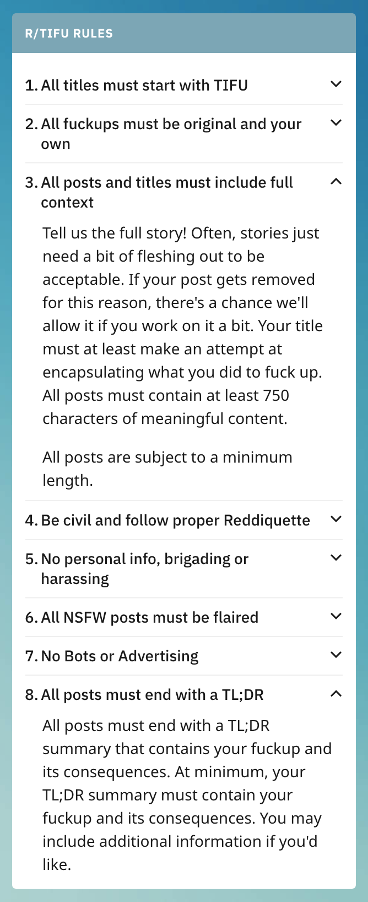
TIFU
Rule #3
All posts and titles must include full context.
Rule #8
All posts must end with a TL;DR
(Too Long Didn’t Read)
Or else removed.
Great conditions for
a summarization dataset!
Notes:
Also, there are mandatory rules for this subreddit.
Titles must have full context and TLDR must be included.
Or else the post will be removed.
This is a perfect condition for a summarization dataset.

Slide 12
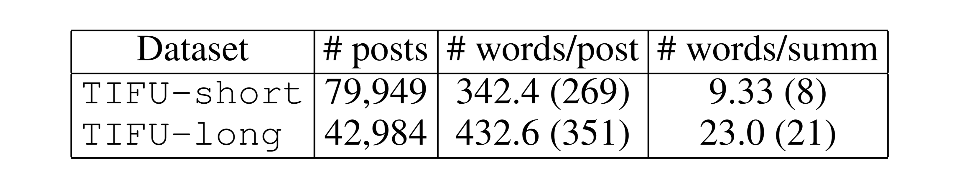
TIFU:
Statistics
(Titles)
(TL;DR)
Total of 120k source text–summary pairs
Vocabulary size: 15k (no consideration of OOV)
Max source text length: 500
Max summary length: 20/50
Notes:
These are the statistics of our TIFU dataset.
We made two subsets. TIFU-short with pairs of source text and title, and TIFU-long with pairs of source text and tldr.
We crawled 5 years of posts and resulted in total 120k text-summary pairs.

Slide 13
Problems with existing datasets
Gold Summary (answer):
Morehouse College seniors got a surprise Sunday when billionaire Robert F. Smith announced that he would pay off the student loan debt. "On behalf of the eight generations of my family who have been in this country, we're going to put a little fuel in your bus," he told the newly minted graduates in Atlanta before saying his family was creating a grant to eliminate their student loans. The announcement was met with a standing ovation and chants of "MVP!” "Now, I know my class will make sure they pay this forward," he continued. "I want my class to look at these (alumni) -- these beautiful Morehouse brothers -- and let's make sure every class has the same opportunity going forward because we are enough to take care of our own community. We are enough to ensure we have all the opportunities of the American dream.” The total amount covered for the 396 students is up to
Morehouse College grads are surprised by a billionaire's promise to pay off their student loans.
The problems with
Formal documents
The leading sentence of a text
Almost identical sentence already inside the text
=Extractive-friendly!
Notes:
Now I’ll show you how the TIFU dataset differs from other existing datasets.

Slide 14
(Recap) Problems with existing datasets 1: Lead bias
Relative locations of bigrams of reference summary in source text
Newsroom
[Grusky et al. 2018]
CNN/DailyMail
[Nallapati et al. 2016]
Notes:
We told you that, in existing datasets, key information is concentrated in the first sentence and called it lead bias.

Slide 15
TIFU:
Weak Lead bias
Newsroom
[Grusky et al. 2018]
CNN/DailyMail
[Nallapati et al. 2016]
Notes:
On the other hand, our TIFU dataset, which is blue, shows more flat and less biased distribution.

Slide 16
TIFU:
Strong Abstraction
2 indicators: Ext-Oracle & Lead
Gold:
The plant-based burger trend is growing more rapidly than most people anticipated.
Lead:
the leading sentence in the text
The meat-less burger trend is growing fast than most people expected.
Notes:
Another characteristic of reddit tifu is it is extremely abstractive.
We assume a dataset is abstractive if extractive method does not work well on the dataset.
We measure it with two extractive methods,
First one is lead, which is the leading sentence in the text

Slide 17
TIFU:
Strong Abstraction
2 indicators: Ext-Oracle & Lead
Gold:
The plant-based burger trend is growing more rapidly than most people anticipated.
Extractive-Oracle (Best-extractive):
the most identical sentence in the text
Experts say that the plant-based burger industry is growing more rapidly than people anticipated.
Notes:
And second one is Extractive oracle, which is the sentence that is the most similar sentence with answer.
And it can be located anywhere in the source text.

Slide 18
TIFU:
Strong Abstraction
2 indicators: Ext-Oracle & Lead
Gold:
The plant-based burger trend is growing more rapidly than most people anticipated.
Lead:
the leading sentence in the text
Extractive-Oracle (Best-extractive):
the most identical sentence in the text
→ If these show low performance,
the dataset is abstractive !
Notes:
So, if these show low performance, then the dataset is abstractive.

Slide 19
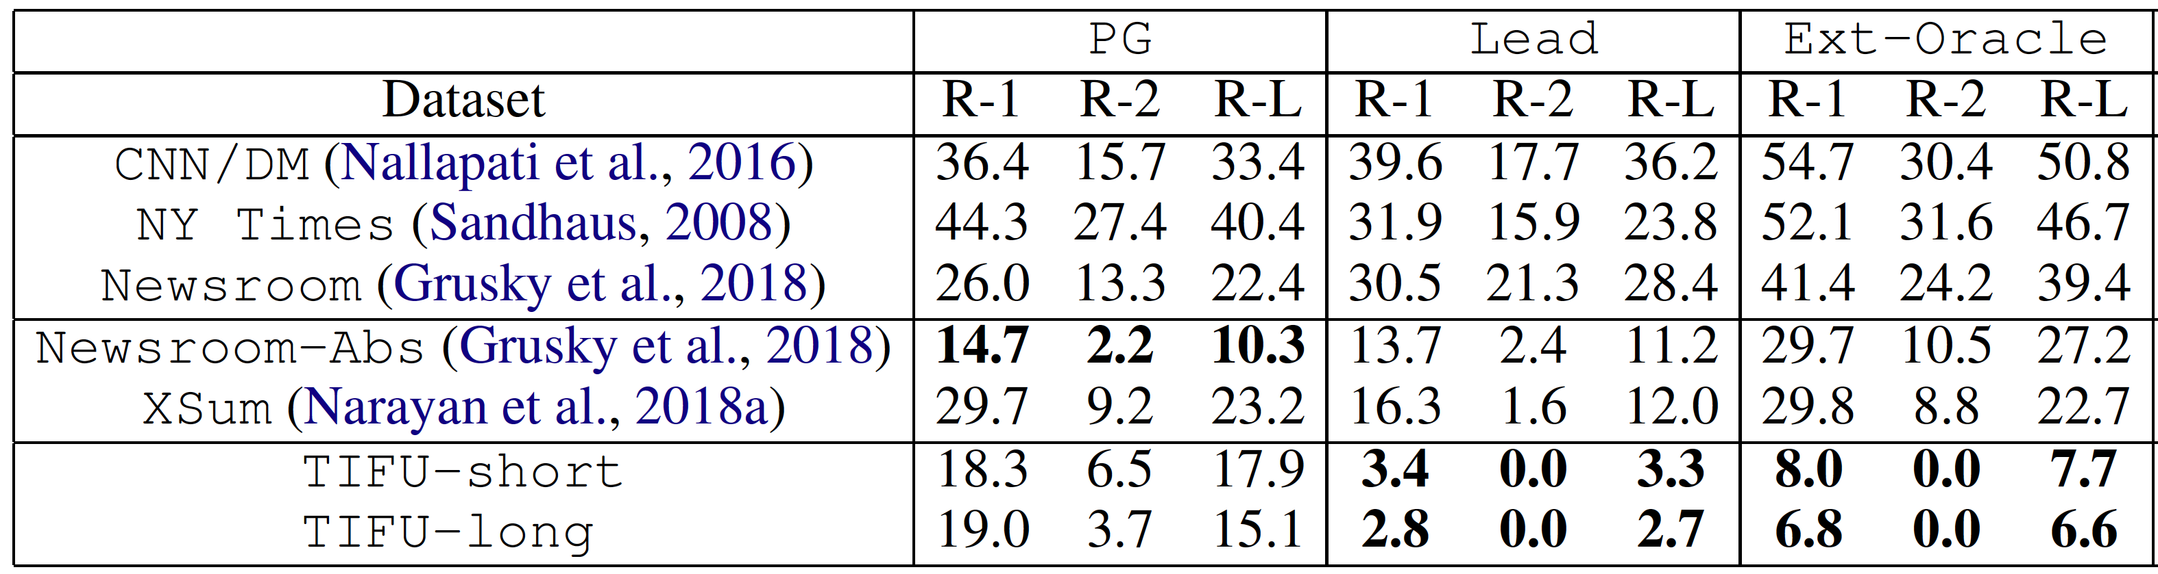
TIFU:
Strong Abstraction
SOTA Abstractive method
^{[1]}
[1] See et al., Get to the Point: Summarization with Point-Generator Networks, ACL, 2017
Notes:
We measured rouge score Pointer-Generator, which is one of the most famous abstractive summarization method, and two extractive methods, lead and extractive oracle.
As you can see, our reddit tifu dataset show extremely low performance with extractive methods, while moderate result with abstractive method. So we can say it shows strong abstraction.

Slide 20
Multi-level Memory Networks
MMN with Convolutions
Document
Sentence
Sentence
Sentence
Word
Word
Word
Word
Word
Notes:
Next we introduce our new model named multi-level memory networks.
What it means that, when we read a text, we have several levels of representations in our mind. The meaning of the word, the meaning of a sentence, and the meaning of the whole document.
So naturally, comprehending these several–levels of representations will lead to better abstractive summaries.
So, our model, fully utilize those representations by saving them in a memory network.

Slide 21
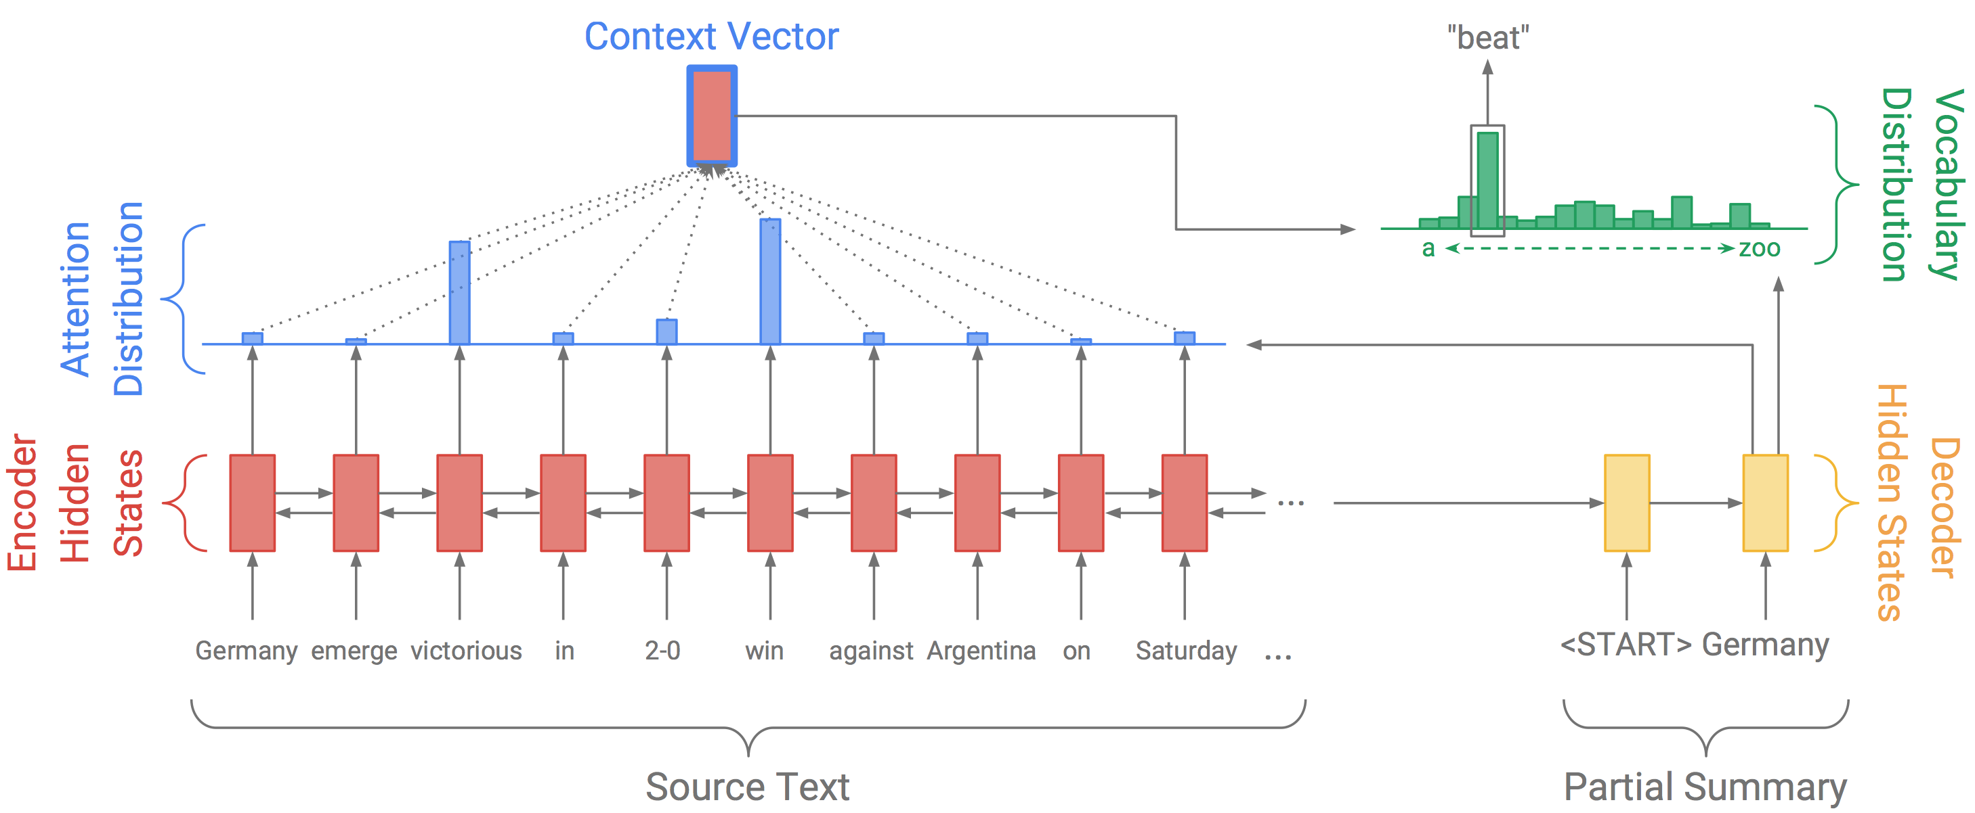
Previous works: Sequence-to-Sequence + Attention [RNN based]
with VAE, pointer network, RL …
See et al., Get to the Point: Summarization with Point-Generator Networks, ACL, 2017
Notes:
Before we start, let’s first review previous works on summarization.
Most of the works are based on RNN sequence to sequence methods.
That is, we encode source text with encoder RNN and generate summary with decoder RNN.

Slide 22
Previous works [RNN]:
Problem 1: Vanishing gradients
Source document is often too long! (document length > 300 words)
Problem 2: All states are connected in a sequence
Cannot build representations of different ranges
Also, attention is applied in word-level
Word
Word
Word
Word
Word
Word
Word
Word
Word
Word
Notes:
However there are some problems with RNN-based methods.
It can suffer from vanishing gradients, because source document is usually very long.
Second, we cannot build representation with different ranges. Because all the states are connected.
Of course we can build it with hierarchical RNNs but in this case, we need explicit segmentations

Slide 23
Multi-level Memory Networks
Can alleviate those problems!
Problem 1: Vanishing gradients
→ Memory networks can capture long term information explicitly
Word
Word
Word
Word
Word
Word
Word
Word
Word
Word
Notes:
On the other hand, with our model, we can alleviate these issues.
They are not processed in a sequence. So no vanishing gradients. Because there are no arrows anymore.

Slide 24
Multi-level Memory Networks
Can alleviate those problems!
Problem 2: All states are connected in a sequence
→ A set of convolution operations with different receptive fields
can capture different ranges of representations (Dilated Convolution^{[1]} )
Word
Word
Word
Word
Word
Word
Word
Word
Word
Word
[1] Yu et al., Multi-scale Context Aggregation by Dilated Convolutions, ICLR, 2016
Notes:
Now, instead of RNNs, convolution is applied to each word representations, as you can see the convolution skips some element from the below level and takes a wider range at the above level. This is called a DILATED convolution.

Slide 25
Multi-level Memory Networks
Overall Architecture
Notes:
Let’s see our MMN with more details

Slide 26
Multi-level Memory Networks
Overall Architecture
Source Text
Summary
Notes:
This is overall architecture of our model. Basically, multi-level memory encodes source text and sequence decoder generate a summary.

Slide 27
Multi-level Memory Networks
Specifically, 4 novel features
1. Writing memory with dilated conv
2. Normalized gated tanh unit
3. Multi-level memory cell
4. Sequence generation w/o RNN
Notes:
There are 4 novel features, and I’ll explain these step by step.
여기서 x가 source text, y가 output summary

Slide 28
Multi-level Memory Networks
Specifically, 4 novel features
1. Writing memory with dilated conv
2. Normalized gated tanh unit
3. Multi-level memory cell
4. Sequence generation w/o RNN
9 convolutional layers
Notes:
We first correlate each words in source text with 9 layers of dilated convolution

Slide 29
Multi-level Memory Networks
Specifically, 4 novel features
1. Writing memory with dilated conv
2. Normalized gated tanh unit
3. Multi-level memory cell
4. Sequence generation w/o RNN
Gated Liner Unit [GLU]
[Gehring et al. 2017]
Notes:
Each convolution is followed by an activation unit. Usually, people use gated linear unit.
In GLU, they normalized with square root of 5 as a fixed constant. But we find that this is kind of bit unintuitive.

Slide 30
Multi-level Memory Networks
Specifically, 4 novel features
1. Writing memory with dilated conv
2. Normalized gated tanh unit
3. Multi-level memory cell
4. Sequence generation w/o RNN
[Gehring et al. 2017]
Notes:
So we replace it with layer normalization. Then we named it as normalized gated tanh unit.

Slide 31
Multi-level Memory Networks
Specifically, 4 novel features
1. Writing memory with dilated conv
2. Normalized gated tanh unit
3. Multi-level memory cell
4. Sequence generation w/o RNN
Notes:
We then build multi-level memory cell.
And this memory cell is core module of our model.

Slide 32
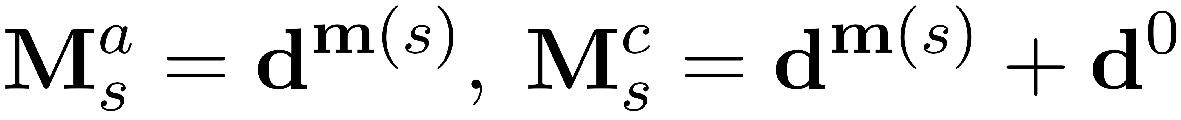
Multi-level Memory Networks
Specifically, 4 novel features
1. Writing memory with dilated conv
2. Normalized gated tanh unit
3. Multi-level memory cell
4. Sequence generation w/o RNN
Memory Value
Memory Key
Layers for memory = {3, 6, 9}
Notes:
To build the memory, we extract embeddings from specific layers of convolution.
So, we have the memory with embeddings from layer 3, embeddings from layer 6 and layer 9.
And that’s why we call it multi-level memory.

Slide 33
Multi-level Memory Networks
Specifically, 4 novel features
1. Writing memory with dilated conv
2. Normalized gated tanh unit
3. Multi-level memory cell
4. Sequence generation w/o RNN
[1] Van Den Oord et al., Wavenet: A Generative Model for Raw Audio, arXiv, 2017
^{[1]}
Notes:
On to the decoding part. We also use convolution based decoder from WAVEnet.

Slide 34
Multi-level Memory Networks
Specifically, 4 novel features
1. Writing memory with dilated conv
2. Normalized gated tanh unit
3. Multi-level memory cell
4. Sequence generation w/o RNN
The encoder’s last layer →
Notes:
We use the final layer of the convolution and maxpool them to get the one embedding of the source text.

Slide 35
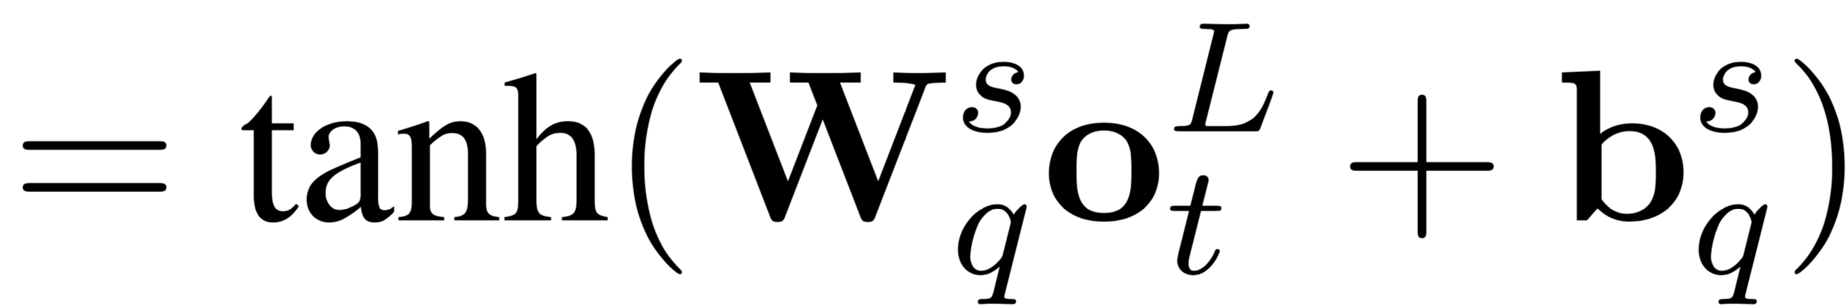
Multi-level Memory Networks
Specifically, 4 novel features
1. Writing memory with dilated conv
2. Normalized gated tanh unit
3. Multi-level memory cell
4. Sequence generation w/o RNN
The encoder’s last layer →
Notes:
We apply convolution to the decoded outputs and get a query to the memory.

Slide 36
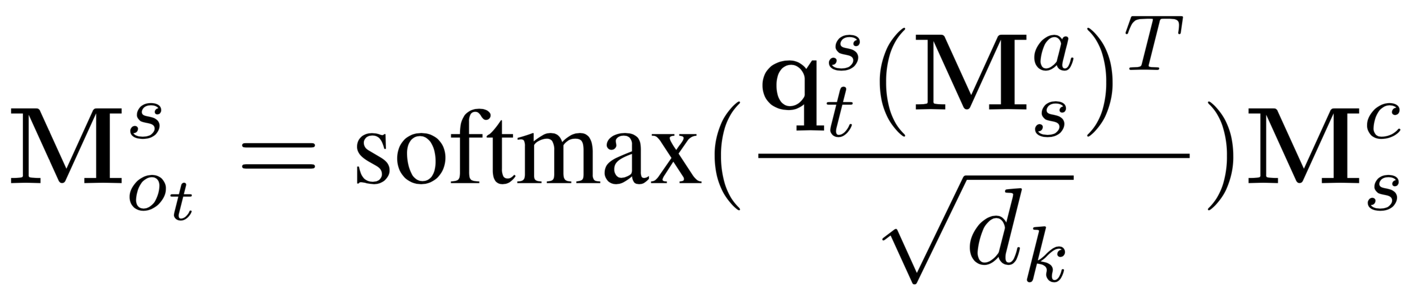
Multi-level Memory Networks
Specifically, 4 novel features
1. Writing memory with dilated conv
2. Normalized gated tanh unit
3. Multi-level memory cell
4. Sequence generation w/o RNN
^{[1]}
The encoder’s last layer →
[1] Vaswani et al., Attention is All You Need, NIPS, 2017
Notes:
And use these queries to read value from the memory and get the attention vector.
And here, since we have 3 memories, we can get three attention vectors.

Slide 37
Multi-level Memory Networks
Specifically, 4 novel features
1. Writing memory with dilated conv
2. Normalized gated tanh unit
3. Multi-level memory cell
4. Sequence generation w/o RNN
The encoder’s last layer →
Notes:
Then this output word will be fed into the decoder once again. The procedure is repeated until End of sentence marker is generated from the decoder.

Slide 38
Multi-level Memory Networks
Specifically, 4 novel features
1. Writing memory with dilated conv
2. Normalized gated tanh unit
3. Multi-level memory cell
4. Sequence generation w/o RNN
Notes:
So that’s our multi-level memory network.

Slide 39
Experiments & Results
On 3 datasets with our MMN
Notes:
Now let’s see how much our proposed model is effective.

Slide 40
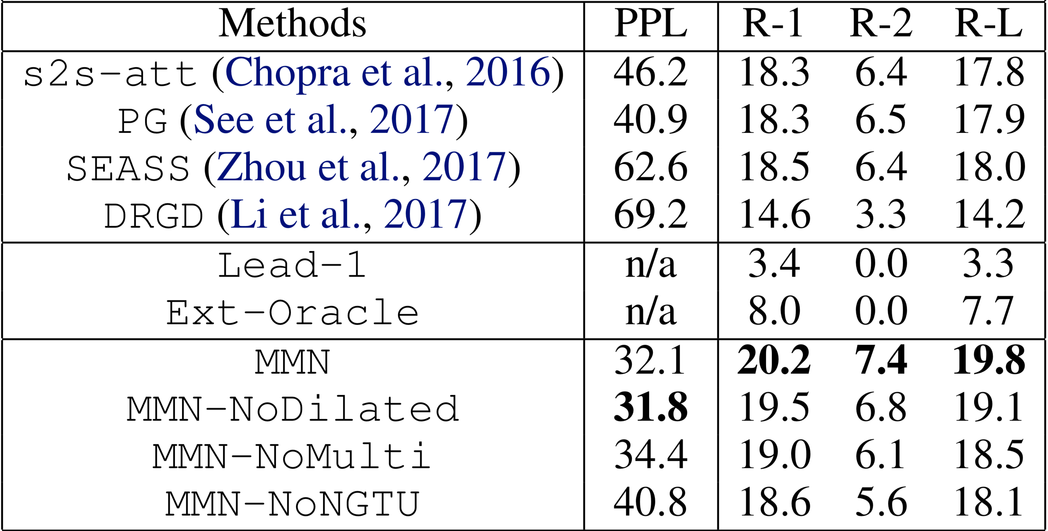
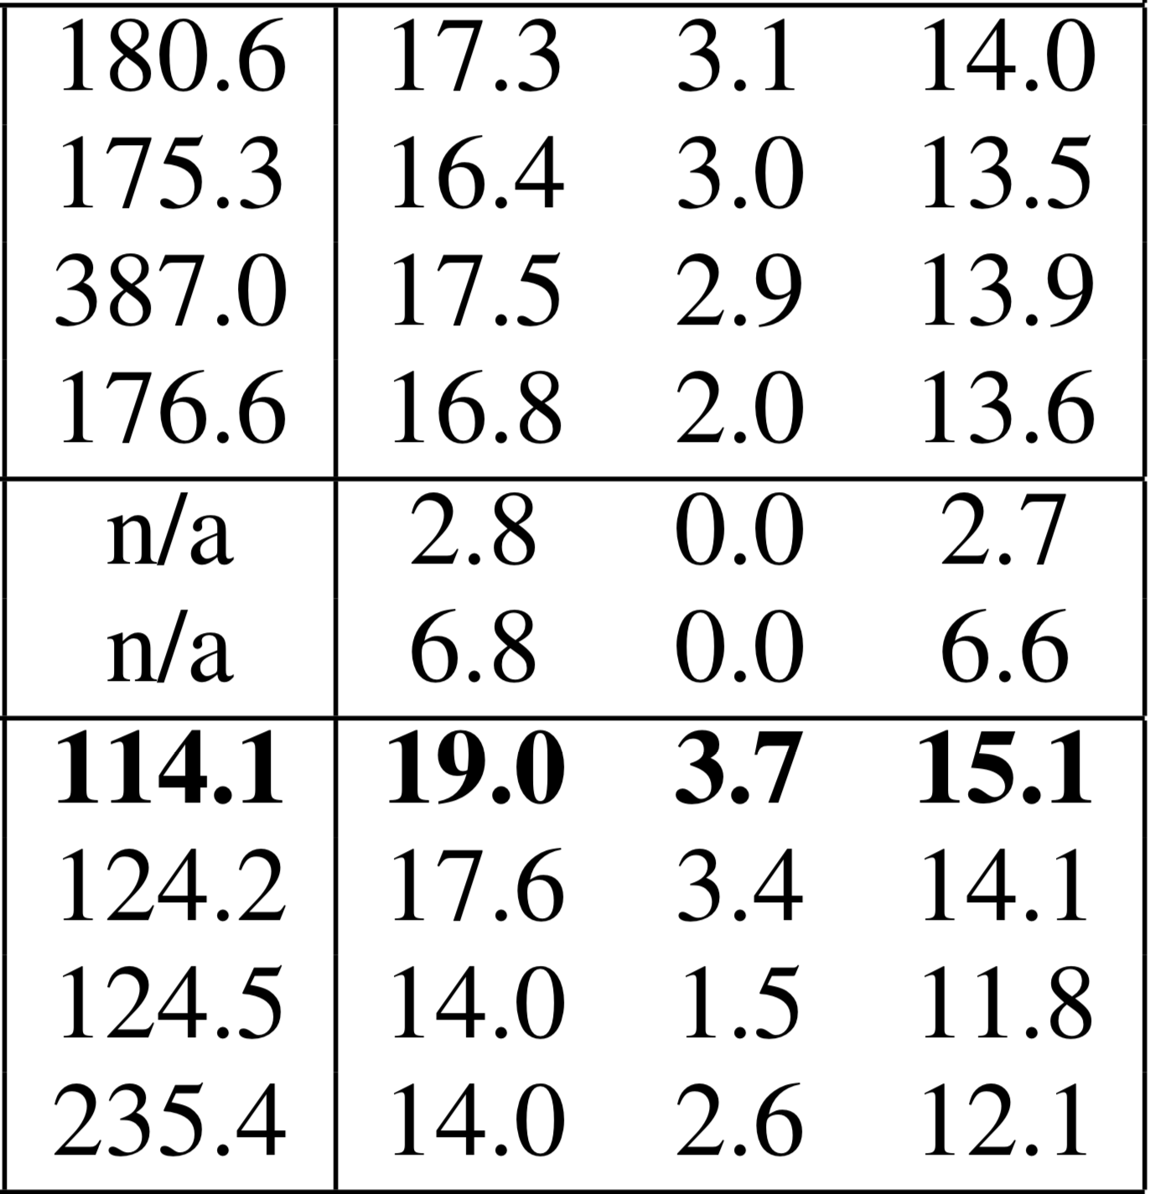
Quantitative results on TIFU
MMN outperforms all other summarization baselines
TIFU-short
TIFU-long
Methods PPL R1 R2 R-L PPL R1 R2 R-L
Notes:
We ran 4 abstractive baselines and 2 extractive baselines.
Additionally, we did 4 ablation study on our MMN model by Dropping each key modules of the MMN.
And found out that the original MMN does better than the ones with missing components.
And, MMN outperforms all other models.

Slide 41
Quantitative results on TIFU
Note the underperformance of extractive methods
compared to abstractive methods
TIFU-short
TIFU-long
Methods PPL R1 R2 R-L PPL R1 R2 R-L
Notes:
Another interesting part here is that extractive methods show extremely low performance on our TIFU dataset.
which means our dataset can be an excellent benchmark for Abstractive summarization models.

Slide 42
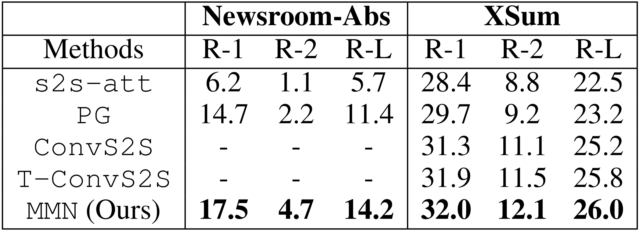
Quantitative results on other abstractive datasets
MMN exceedingly outperforms on Newsroom-Abs and XSum
^{[1]}
^{[2]}
[1] Grusky et al., Newsroom: A Dataset of 1.3 Million Summaries with Diverse Extractive Strategies, NAACL, 2018
[2] Narayan et al., Don’t Give Me the Details, Just the Summary! Topic-Aware Convolutional Neural Networks for Extreme Summarization,
EMNLP, 2018
Notes:
We also ran experiments on TWO other abstractive datasets.
Again, our model outperforms all the baselines.

Slide 43

Qualitative results with
mechanical turk
Artificial Artificial Intelligence
Users significantly prefer
our MMN results to those of baselines on TIFU
Notes:
Finally we ran user studies at the Amazon Mechanical Turk, and got reports that people significantly prefer our summary.

Slide 44
Concluding Remarks
New dataset
TIFU
→ Relaxing the bias problem in existing datasets
Multi-level Memory Network
→ Capturing different levels of representations
& long term information
Document
Extensive experiments
→ Experimented on 3 datasets
Run 5 baseline models
Went through 4 ablation studies
Performed user studies via AMT
Sentence
Sentence
Sentence
Word
Word
Word
Word
Word
Notes:
So, to sum up, we proposed a new dataset named reddit TIFU.
And this dataset relaxes the bias problem in existing datasets.
We also proposed a new model multi-level memory network, which captures different levels of representations.
And also ran extensive experiments on it. With 3 datasets, as well as user studies through Amazon Mechanical Turk.

Slide 45
Thank you
https://github.com/ctr4si/MMN
Notes:
Our code and dataset will be available at the github. Thank you.

Slide 46
Backup Slides
Notes:
질문리스트
왜 transformer를 안썼냐?
Hierarchical rnn 도 unsupervised로 하는거 있는데?

Slide 47
TIFU:
Weak Lead bias
6 4 2 0
Newsroom
CNN/DailyMail
Newsroom-Abs
XSum
Reddit TIFU
Density
0.25 0.50 0.75
0.25 0.50 0.75
0.25 0.50 0.75
0.25 0.50 0.75
0.25 0.50 0.75
Relative Location
Notes:
We compared the figures among diverse existing datasets.
The more flat, the less biased.
And as you can see the TIFU dataset has weak lead bias than others.

Slide 48
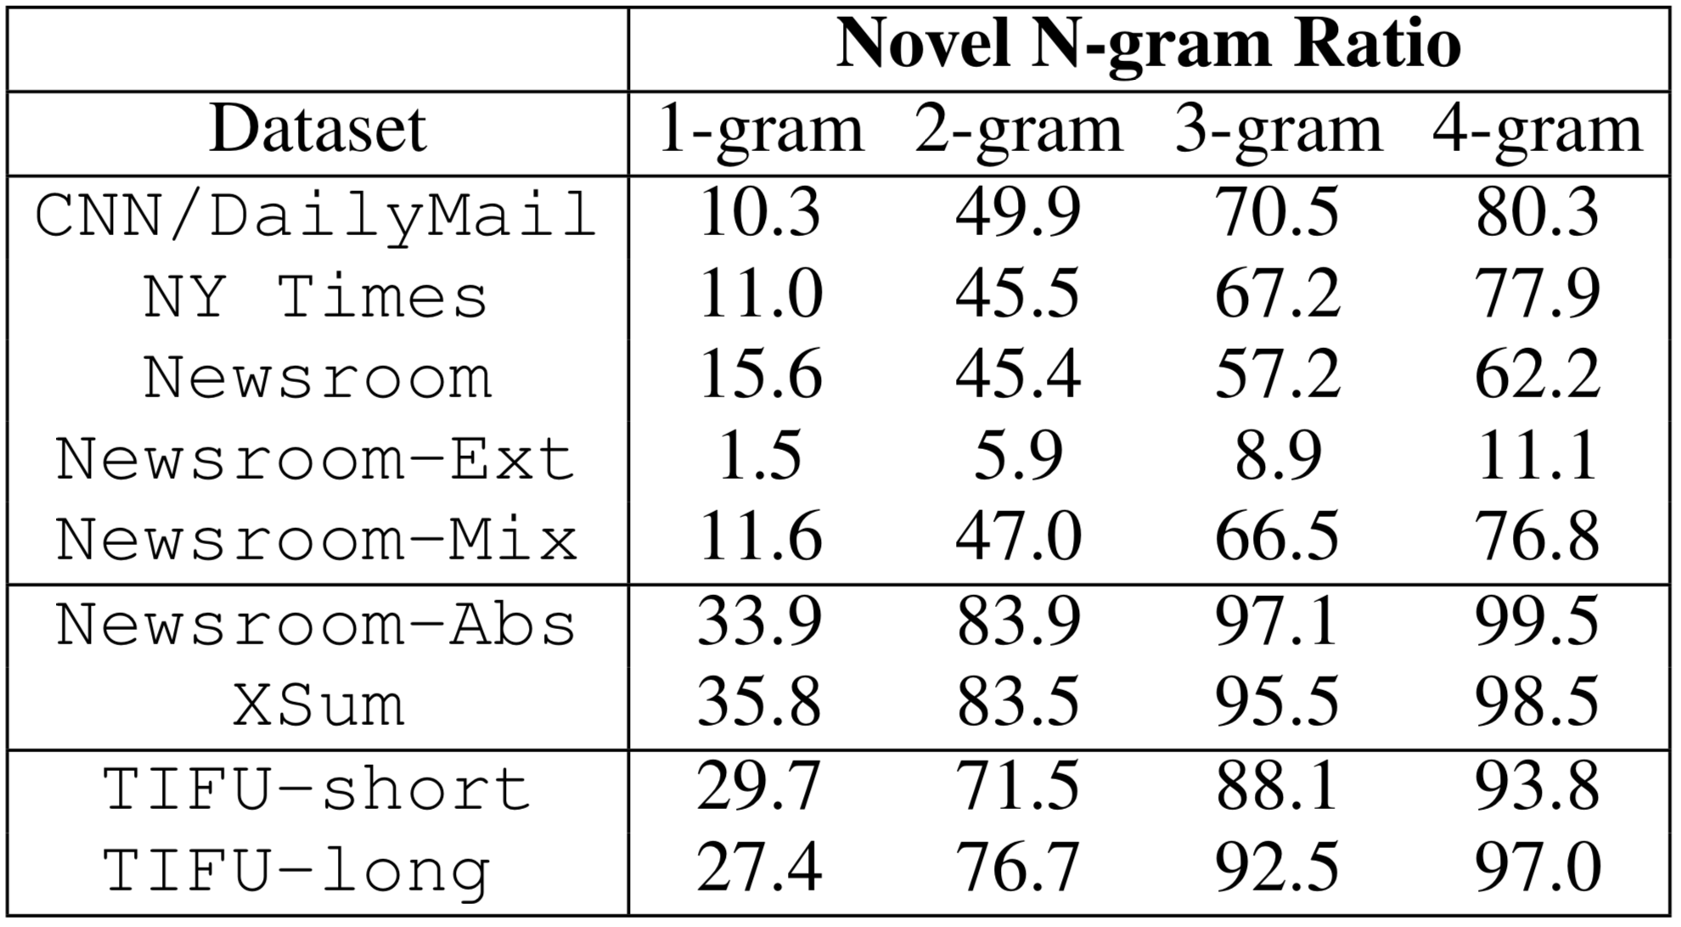
TIFU:
Novel N-gram Ratio

Slide 49
Training Details
Word embeddings are initialized using fastText^{[1]}
Weight normalization^{[2]} is applied to all layers
Applied label smoothing^{[3]}
Cross entropy loss
Uniform prior
[1] Bojanowski et al., Enriching Word Vectors with Subword Information, TACL, 2016
[2] Salimans and Kingma, Weight Normalization: A Simple Reparameterization to Accelerate Training of DNN, NIPS, 2016
[3] Pereyra et al., Regularizing Neural Networks by Penalizing Confident Output Distributions, ICLR, 2017
Notes:
For the training, we used cross entropy with uniform prior for label smoothing.
We used fast text to initialize word embeddings.

Slide 50
TIFU:
Strong Abstraction
SOTA Abstractive method
Extractive-Oracle :
the most identical sentence in the text (by ROUGE metric)
Lead:
the leading sentence in the text
→ If these show low performance, the dataset is abstractive
Notes:
Another characteristic of reddit tifu is it is extremely abstractive. We assume a dataset is abstractive if extractive method does not work well on the dataset.
We measure it with two extractive methods, extractive oracle and lead. Extractive oracle is the sentence that is the most similar sentence with answer and lead is the leading sentence in the text.
As you can see, our reddit tifu dataset show extremely low performance with extractive methods, while moderate result with abstractive method. So we can say it shows strong abstraction.
=======================
Another characteristic of reddit tifu is it is extremely abstractive.
We assume a dataset is abstractive if extractive method does not work well on the dataset.
We measure it with two extractive methods, extractive oracle and lead.
Extractive oracle is the sentence that is the most similar sentence with answer and lead is the leading sentence in the text.
As you can see, our reddit tifu dataset show extremely low performance with extractive methods, while moderate result with abstractive method.
So we can say it shows strong abstraction.

